Slide 1
Purdue Extension – The Education Store
Get Outta the Past, Get Into Magento!
or: How Purdue modernized their e-commerce platform and learned to get with the times
2025-06-04

Slide 2
Introductions
Purdue Extension – The Education Store
https://edustore.purdue.edu
edustore@purdue.edu

Slide 3
Introductions
Purdue Extension – The Education Store
https://edustore.purdue.edu
edustore@purdue.edu
Erin Watson – Manager, The Education Store, Purdue University
watso214@purdue.edu

Slide 4
Introductions
Purdue Extension – The Education Store
https://edustore.purdue.edu
edustore@purdue.edu
Erin Watson – Manager, The Education Store, Purdue University
watso214@purdue.edu
Eric Imboden – Extension IT Specialist, Purdue University
eimboden@purdue.edu

Slide 5
History (2003ish-2024)
How it started…
Purdue Extension’s Education Store launched sometime in early 2000s (no real records, but oldest files were dated 2003)
Provided an online storefront where people could find free, online resources (reports, guides, factsheets, etc.) and paid publications (books, posters, etc.) compiled and made available by Purdue’s Ag departments
Website architecture
ASP front-end running on Windows Server/IIS
FileMaker Pro database as back-end

Slide 6
History (2003ish-2024)
How it started…
System Limitations
While the site allowed online credit card sales, other types of transactions like check/money order, invoice, or internal transfer required manual entry
Tiered shipping rates (no real-time shipping quotes, no direct links to shipping providers)
$300 limit on online orders (>$300 required call-in and manual entry by Erin’s team)
Limited/strict search capabilities
No front-end edits by Ed Store staff (required IT assistance – 1 resource)
Back-end inventory, order, and customer management – as well as all reporting – done via FMP

Slide 7
History (2003ish-2024)
How it started…
The old Education Store
What was the site like before?

Slide 8
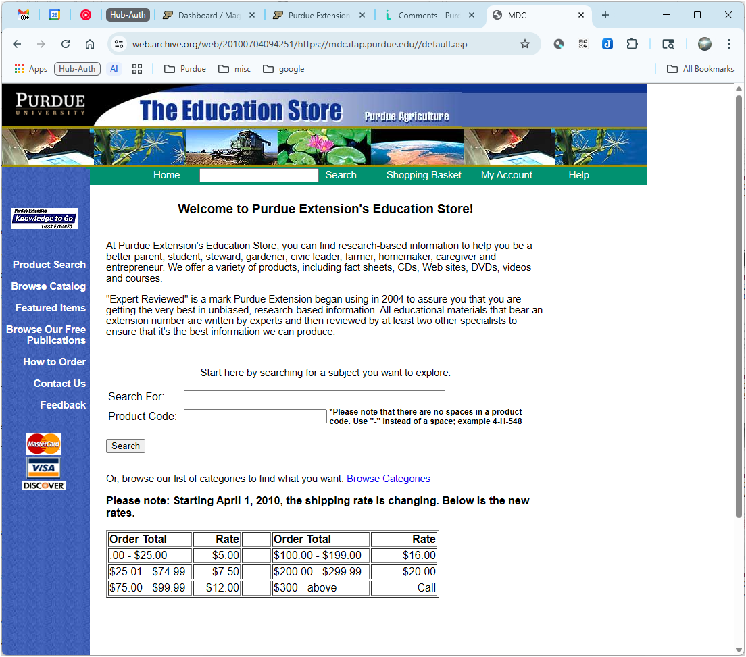
History (2003ish-2024)
How it started…
The old Education Store
Front-end
First snapshot available on the WayBack Machine (web.archive.org) is from 2010…

Slide 9
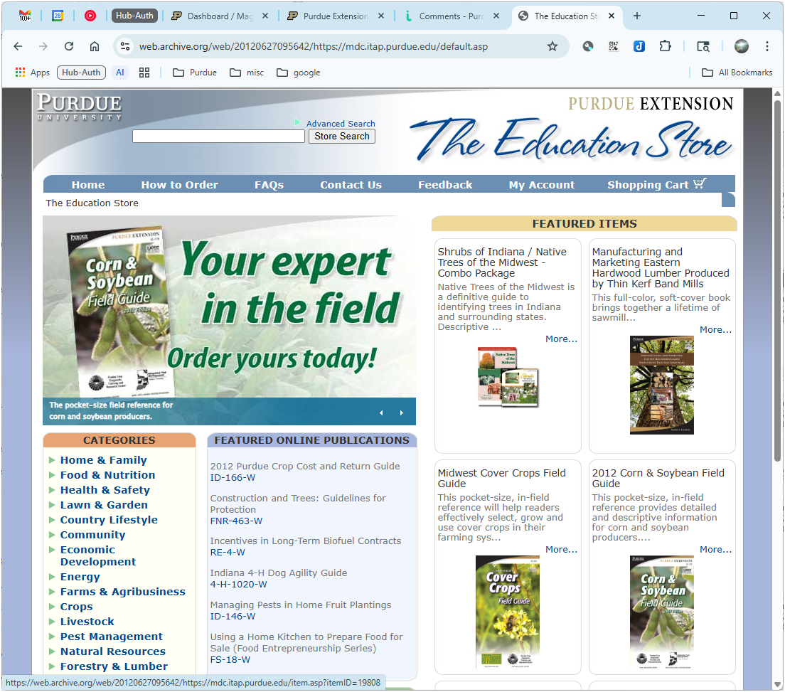
History (2003ish-2024)
How it started…
The old Education Store
Front-end
Circa 2012…new design, shopping cart, better navigation, more graphics, etc.

Slide 10
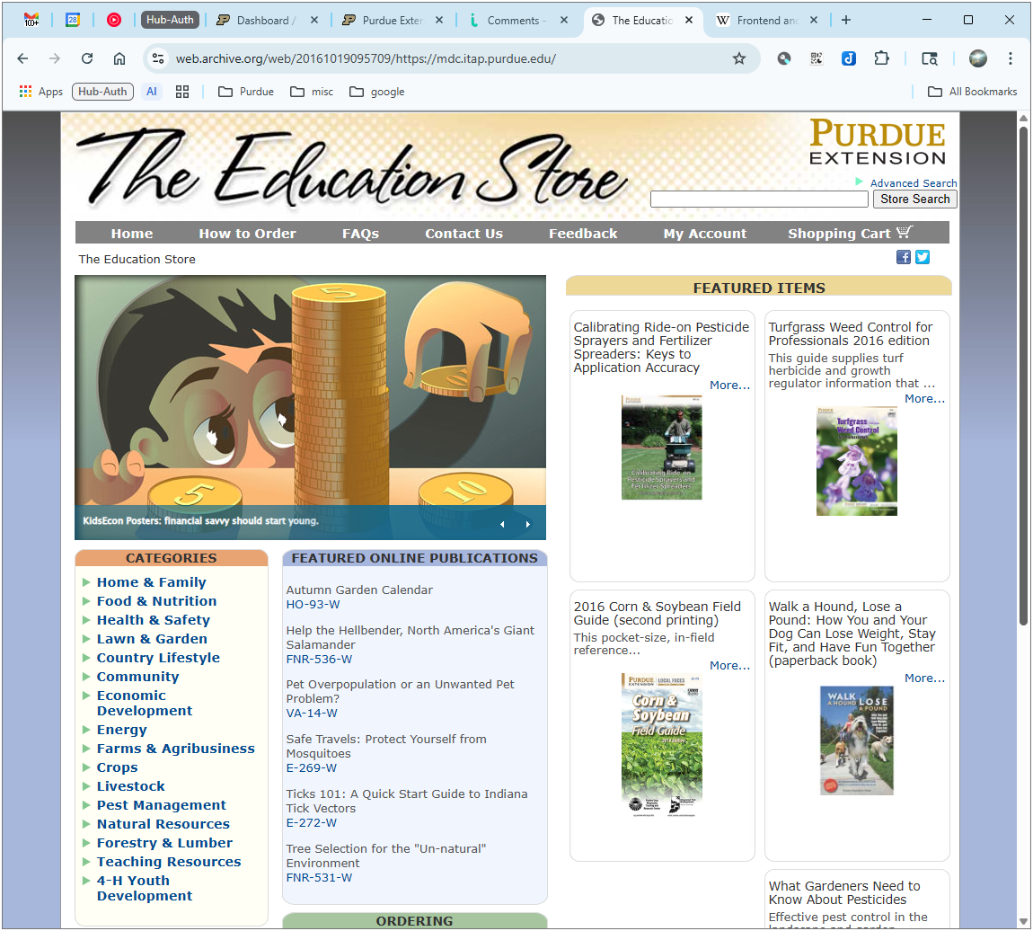
History (2003ish-2024)
How it started…
The old Education Store
Front-end
2015…refinements, no substantial changes

Slide 11
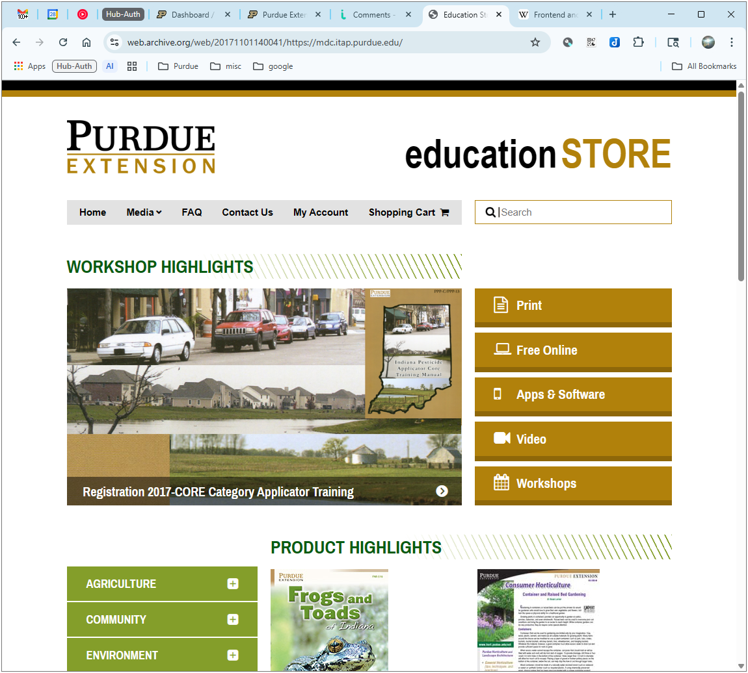
History (2003ish-2024)
How it started…
The old Education Store
Front-end
2017…another redesign, more focus on Purdue branding, expanded navigation options
Note: This is how the Education Store looked when Erin came to Purdue Extension in 2018.

Slide 12
History (2003ish-2024)
How it started…
The old Education Store
Front-end
2021…one final design tweak, strictly Purdue branding/logo changes
Note: This is how the Education Store looked when Eric came to Extension in 2022.

Slide 13
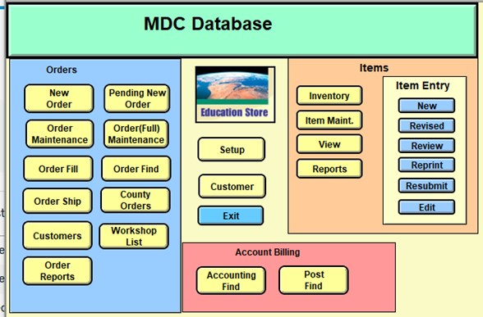
History (2003ish-2024)
How it started…
The old Education Store
Back-end (FileMaker Pro)
Home screen – Main menu

Slide 14
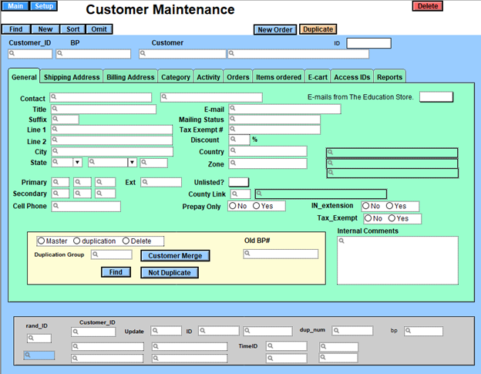
History (2003ish-2024)
How it started…
The old Education Store
Back-end
Customer maintenance screen

Slide 15
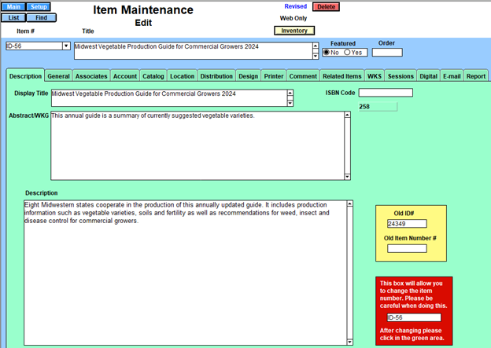
History (2003ish-2024)
How it started…
The old Education Store
Back-end
Product/Item maintenance screen

Slide 16
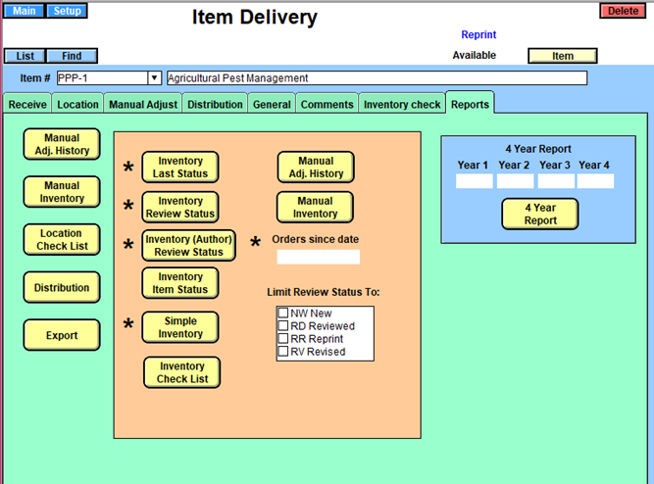
History (2003ish-2024)
How it started…
The old Education Store
Back-end
Item/Inventory maintenance screen

Slide 17
History (2003ish-2024)
How it started…
Drivers for change
IIS/ASP became difficult to manage. Most of the university had moved to Cascade, WordPress, and PHP sites on Apache. IIS/ASP still supported, but more difficult to find IT support.
FileMaker Pro lagged behind current version. Windows Server kept us from upgrading FMP, so increasingly out of date.
PCI DSS 4 compliance deadline loomed large…current system unlikely to pass
Needed better front- and back-end solution (more customizable, more up-to-date, more expandable)
Wanted more modern e-commerce experience, better cart management, more online payment options, real-time shipping, etc.
The Education Store project - Refresh/Renew/Replace
2018 – 2022: Multiple failed attempts to develop new system
2023: Restart from scratch

Slide 18
History (2003ish-2024)
How it started…
Goals and requirements
Must facilitate sale of both physical and downloadable/virtual (primarily PDF) products
Must handle both paid and free items
Must integrate with Touchnet or Chase payment systems
To satisfy IT Security PCI concerns, must provide standalone, hosted payment page
Must NOT present payment page in iframe
Must handle online credit card sales, but allow check/money order, invoice, and internal transfer sales as well
Must provide at least basic reporting, including analytics, sales data, customer data, inventory status, etc.
Should integrate with shipping providers to provide real-time shipping estimates
Should allow tax exempt customer management
Should allow Ed Store staff to manage site content (categories, products, pages, and other elements) independently…with little to no IT support

Slide 19
History (2003ish-2024)
How it started…
Search for a new platform
Several options considered (Shopify, WooCommerce, BigCommerce, Touchnet uStore, Adobe Commerce)
Adobe Commerce stood out, but $50,000+/year license fee seemed too high…until we discovered
Adobe Commerce = Licensed, supported, and hosted version of Magento
Magento = very mature (2008-present), free, open source e-commerce platform which runs well on LAMP
Adobe recommended an e-commerce consulting partner familiar with Magento (IWD Agency)

Slide 20
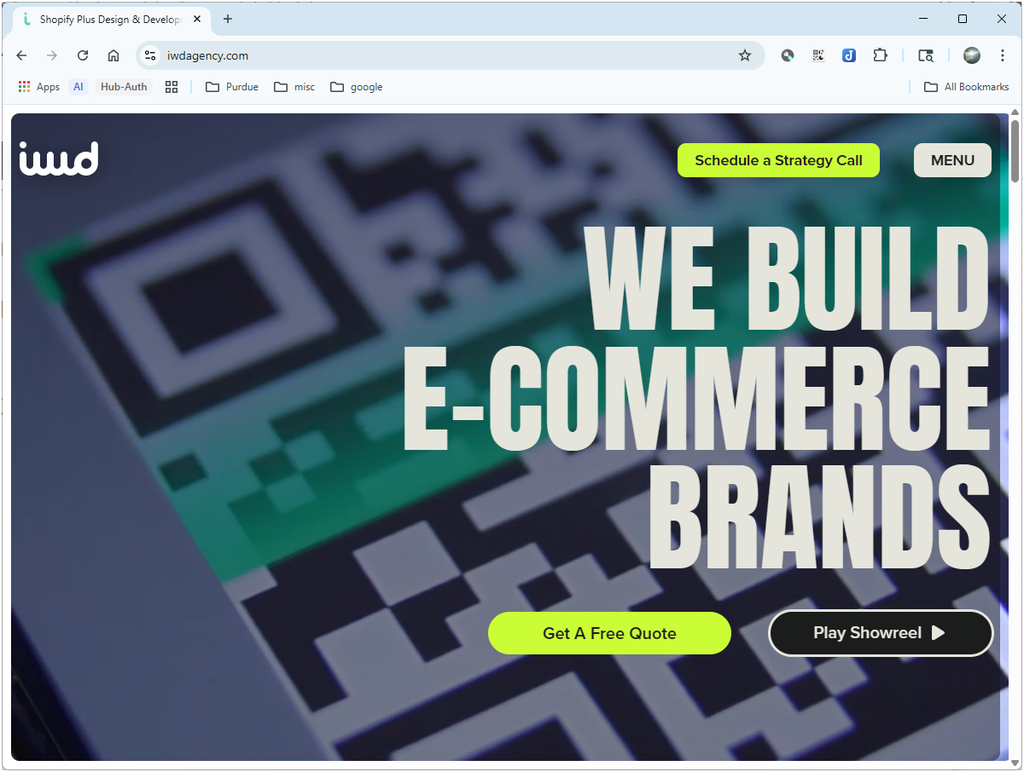
History (2003ish-2024)
How it started…
The Magento Project
Engaged services of IWD Agency, an e-commerce consulting and integration partner, to help with design, implementation, and ongoing maintenance
IWD based in Austin, TX, also with offices in Spain, Brazil, Ukraine, and India
IWD has experience with all major e-commerce platforms, but specifically recommended for Adobe Commerce (Magento) expertise
IWD had experience with higher ed, and in fact worked with Penn State on their Extension site/store

Slide 21
History (2003ish-2024)
How it started…
The Magento Project – Timeline
Fall 2023 – preliminary talks with IWD
Discussed Adobe Commerce
Established project drivers/goals
Engaged Purdue IT Security
Pivoted to Magento on Purdue servers

Slide 22
History (2003ish-2024)
How it started…
The Magento Project – Timeline
Fall 2023 – preliminary talks with IWD
Discussed Adobe Commerce
Established project drivers/goals
Engaged Purdue IT Security
Pivoted to Magento on Purdue servers
Spring 2024 – Signed contract with IWD and began development
Stood up dev and prod servers, installed components, confirmed basic functionality
Completed style guide (incorporated Purdue branding)
Began process to export 2000+ products from old store, import into Magento

Slide 23
History (2003ish-2024)
How it started…
The Magento Project – Timeline
Fall 2023 – preliminary talks with IWD
Discussed Adobe Commerce
Established project drivers/goals
Engaged Purdue IT Security
Pivoted to Magento on Purdue servers
Spring 2024 – Signed contract with IWD and began development
Stood up dev and prod servers, installed components, confirmed basic functionality
Completed style guide (incorporated Purdue branding)
Began process to export 2000+ products from old store, import into Magento
Summer/Fall 2024 – Continued installations, configuration, and refinement
Identified extensions for additional functionality
Engaged IWD to develop custom solutions/reports as necessary
Fixed problems, put out fires…rinse and repeat
Developed front-end content and finalized category structure

Slide 24
History (2003ish-2024)
How it started…
The Magento Project – Timeline
Fall 2023 – preliminary talks with IWD
Discussed Adobe Commerce
Established project drivers/goals
Engaged Purdue IT Security
Pivoted to Magento on Purdue servers
Spring 2024 – Signed contract with IWD and began development
Stood up dev and prod servers, installed components, confirmed basic functionality
Completed style guide (incorporated Purdue branding)
Began process to export 2000+ products from old store, import into Magento
Summer/Fall 2024 – Continued installations, configuration, and refinement
Identified extensions for additional functionality
Engaged IWD to develop custom solutions/reports as necessary
Fixed problems, put out fires…rinse and repeat
Developed front-end content and finalized category structure
Late Jan 2025 – New store officially launched, bringing us to…

Slide 25
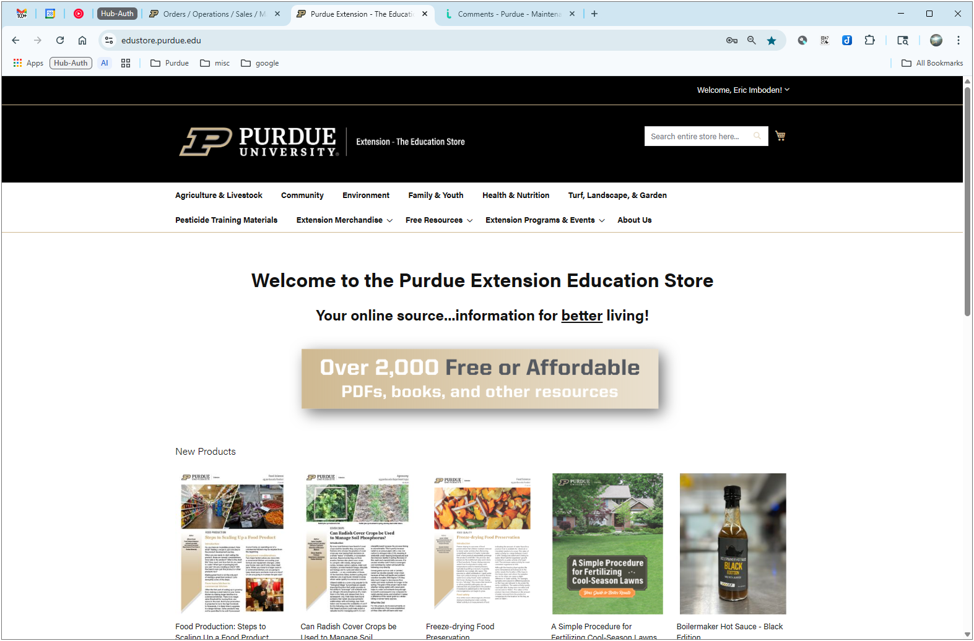
Current Day (2025-?)
How it’s going…
The new Education Store

Slide 26
Current Day (2025-?)
How it’s going…
The new Education Store
Launched January 29, 2025
First 100 days of operation:
> 2700 customer accounts created
> 3000 orders placed (over 50% for free downloadable products)

Slide 27
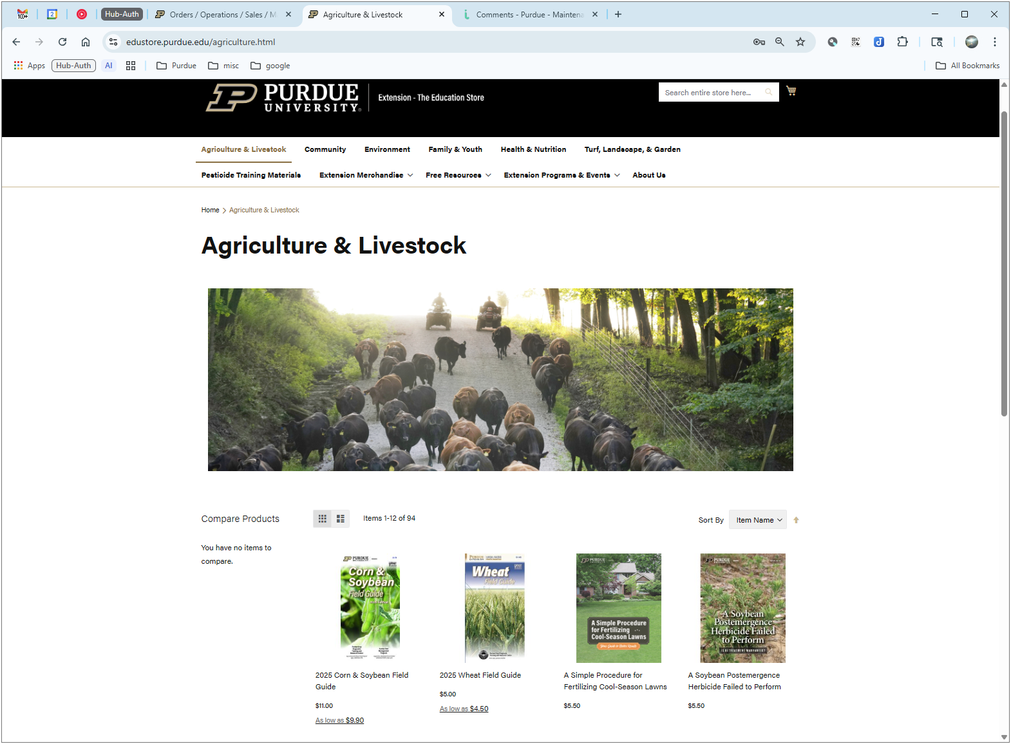
Current Day (2025-?)
How it’s going…
The new Education Store
Front-end
Category pages can show custom graphics, text, and other content
All category products listed in a grid
Products sortable by product name, date, price, or other custom attributes

Slide 28
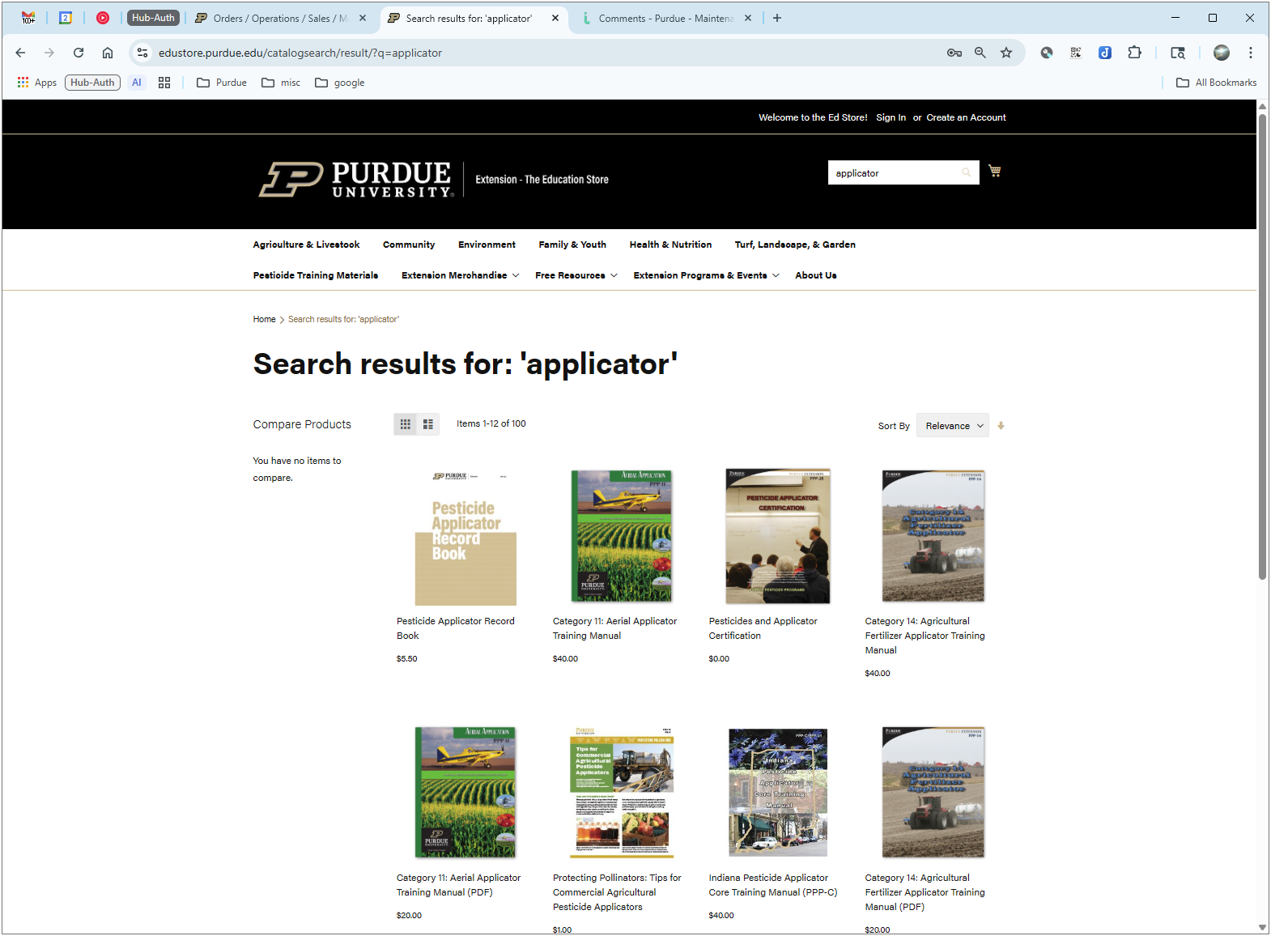
Current Day (2025-?)
How it’s going…
The new Education Store
Front-end
Enhanced searching capabilities, including fuzzy, partial match, keywords, etc.
Search results grid sortable by relevance, price, or other attributes

Slide 29
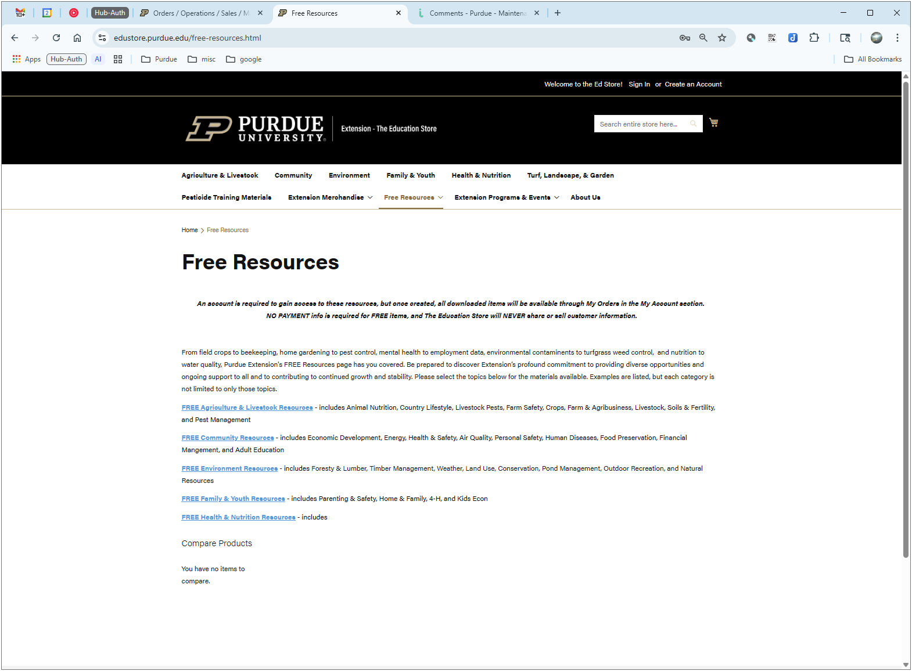
Current Day (2025-?)
How it’s going…
The new Education Store
Front-end
Custom pages and blocks let us organize links, categories, and sub-categories as needed

Slide 30
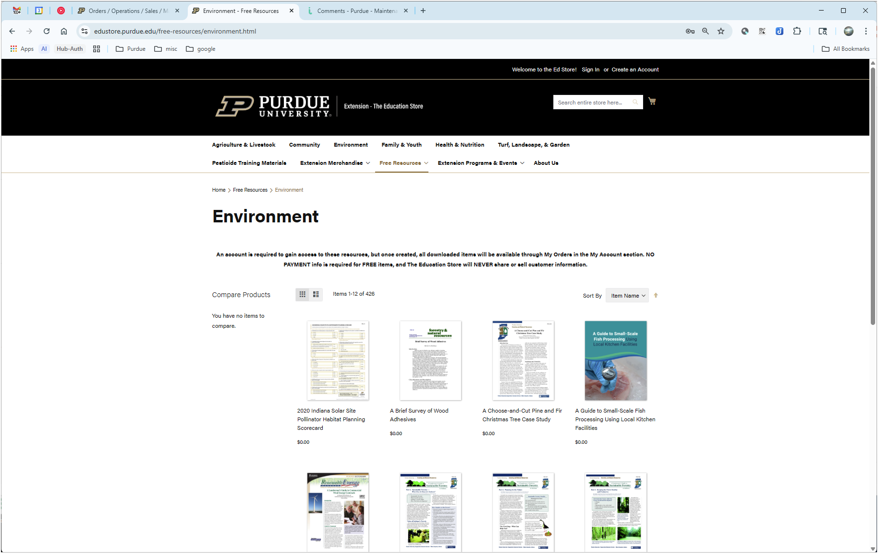
Current Day (2025-?)
How it’s going…
The new Education Store
Front-end
Custom pages and blocks let us organize links, categories, and sub-categories as needed
Navigating to sub-categories presents only relevant products

Slide 31
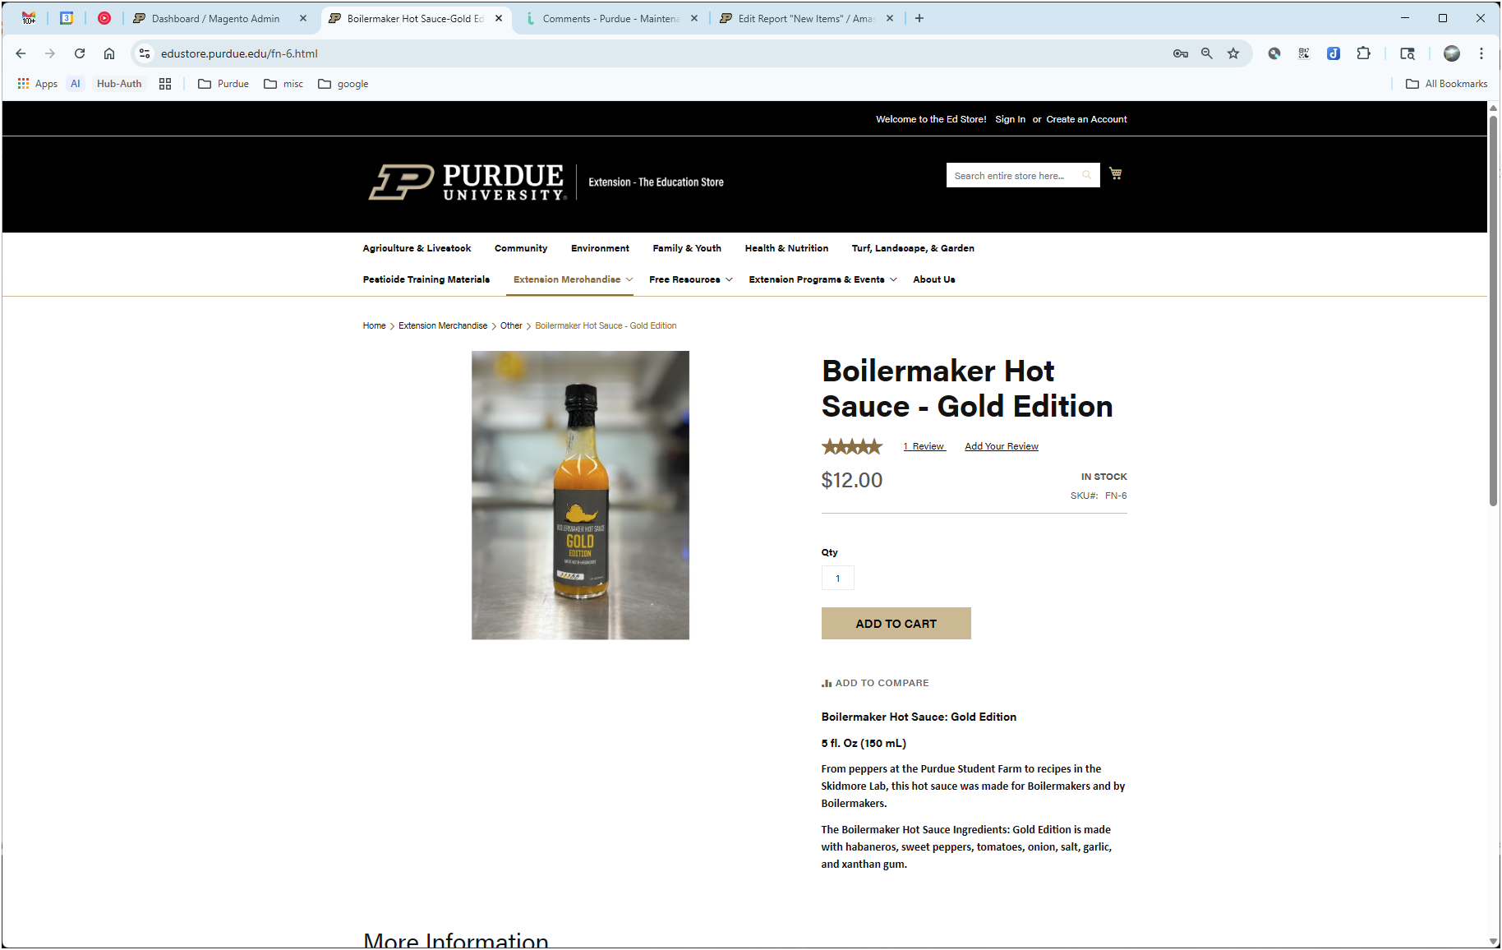
Current Day (2025-?)
How it’s going…
The new Education Store
Front-end
Custom pages and blocks let us organize links, categories, and sub-categories as needed
Navigating to sub-categories presents only relevant products
Product pages then show more detail, images, in-stock status, and “Add to cart” button for all products

Slide 32
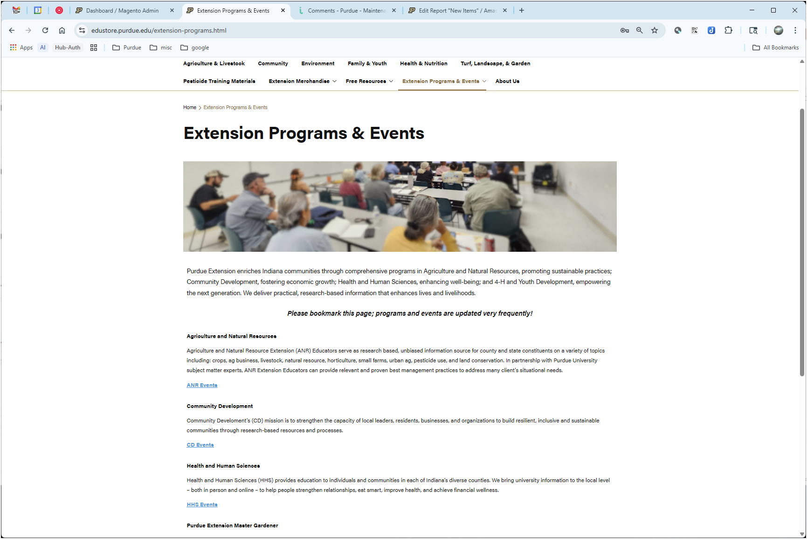
Current Day (2025-?)
How it’s going…
The new Education Store
Front-end
Custom content for each category lets us embed other information, including dynamic content

Slide 33
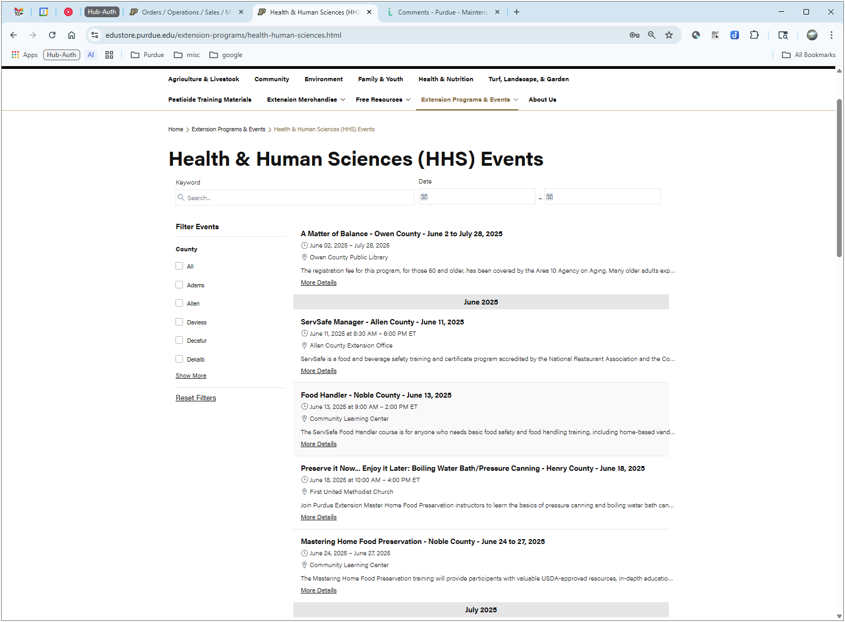
Current Day (2025-?)
How it’s going…
The new Education Store
Front-end
Custom content for each category lets us embed other information, including dynamic content
Example – this screen shows a live feed of HHS events from our Cvent system

Slide 34
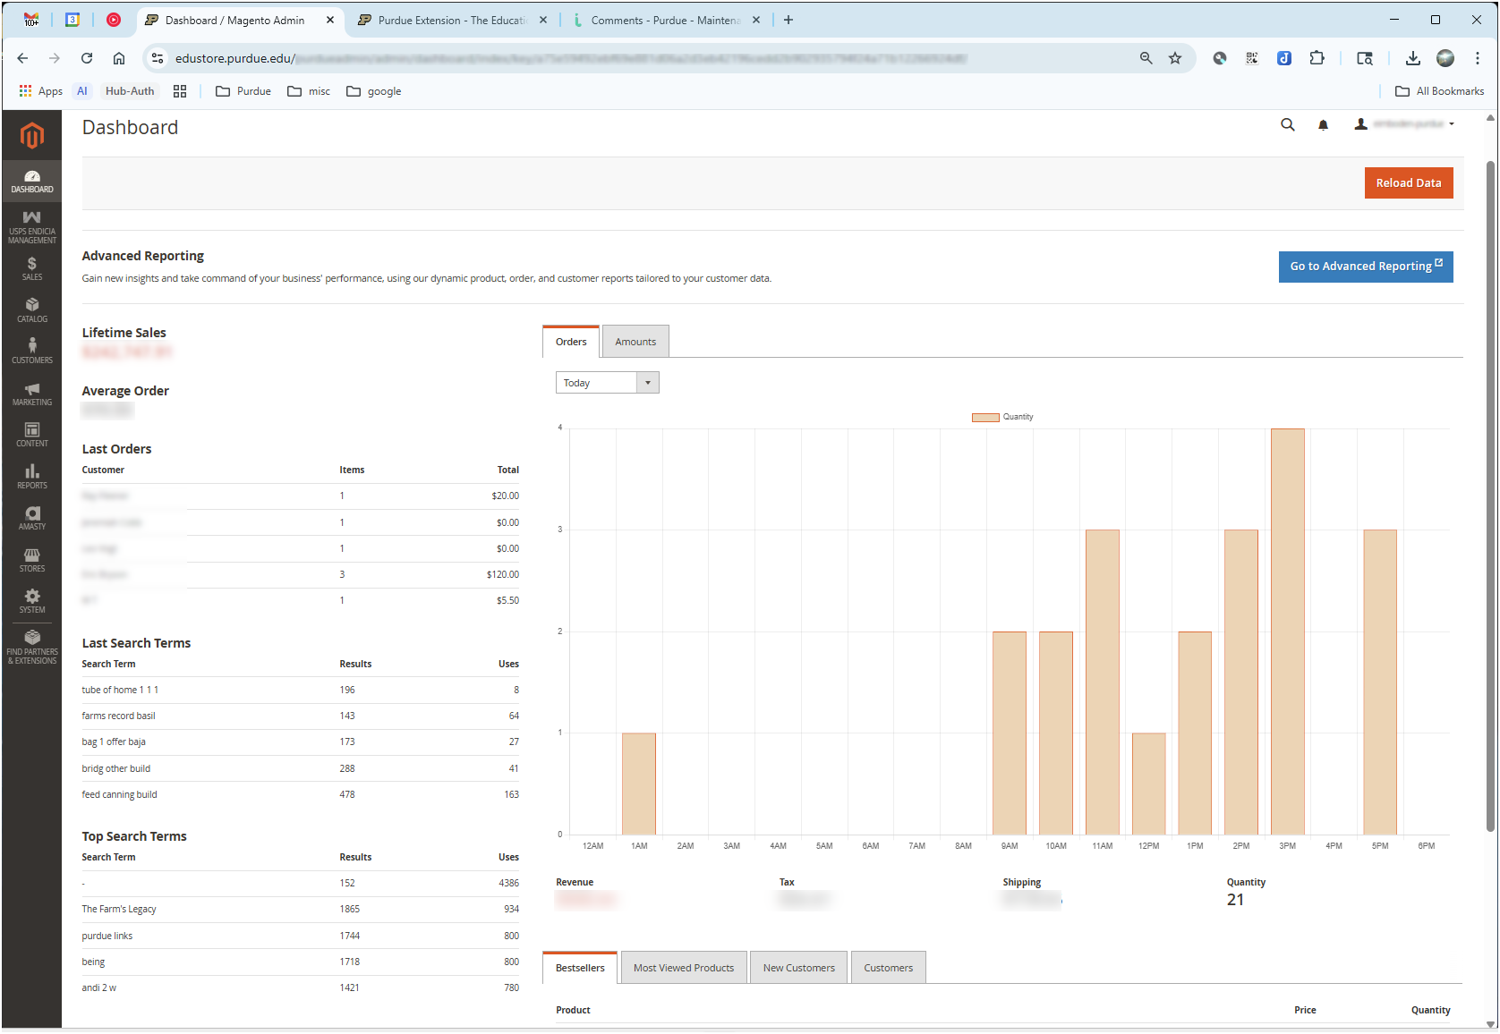
Current Day (2025-?)
How it’s going…
The new Education Store
Back-end

Slide 35
Current Day (2025-?)
How it’s going…
The new Education Store
Back-end
Admin dashboard gives Ed Store staff quick view of the current state of the store
Modern user interface allows easy navigation to any part of the admin

Slide 36
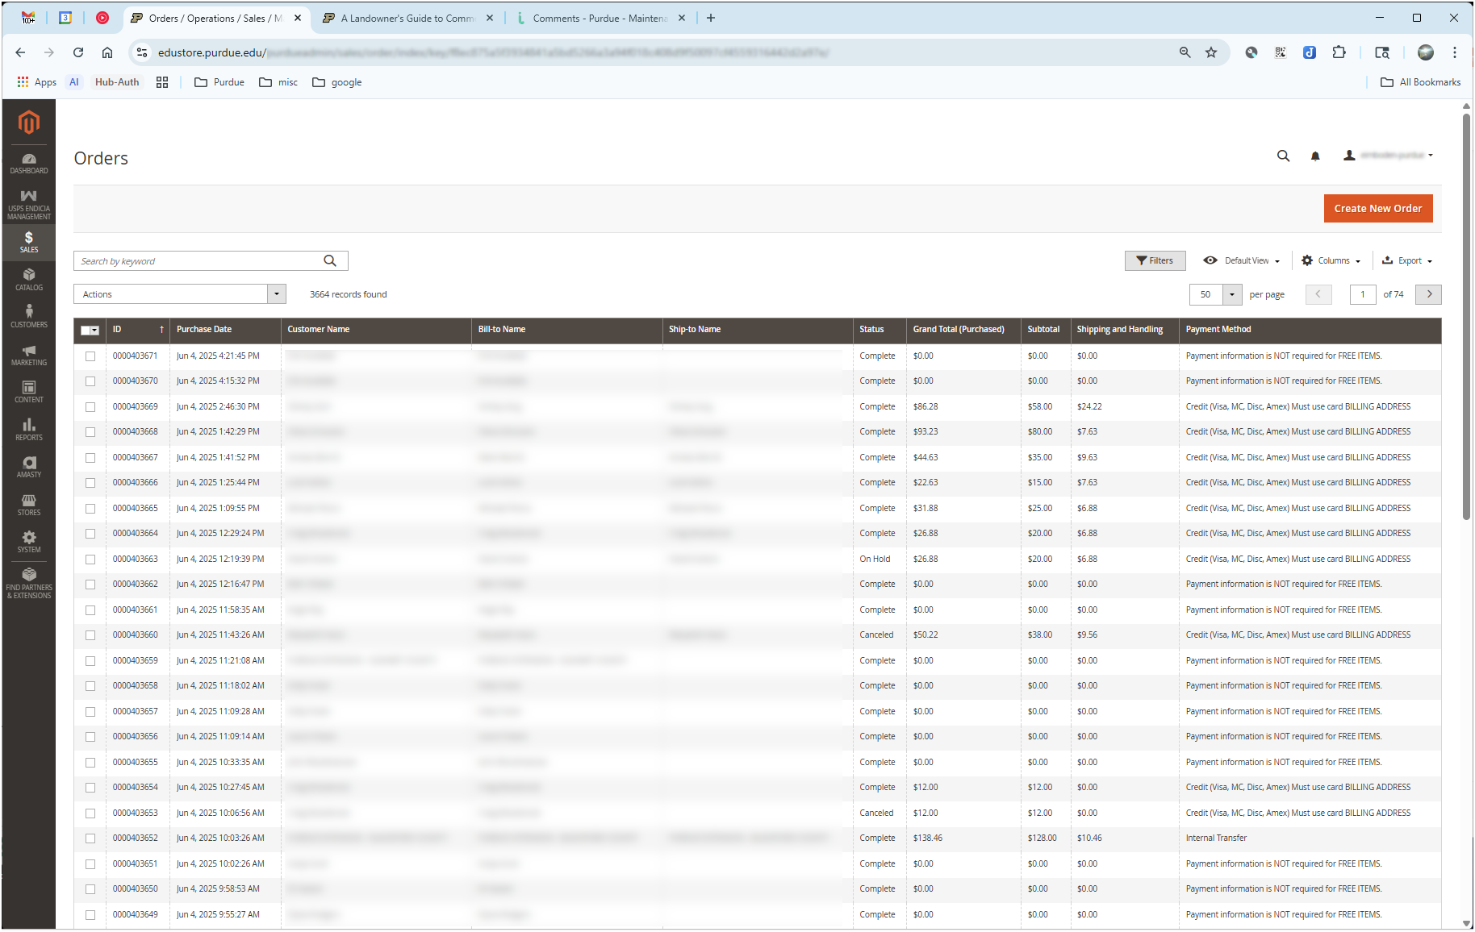
Current Day (2025-?)
How it’s going…
The new Education Store
Back-end
Order Management allows quick view of all orders…

Slide 37
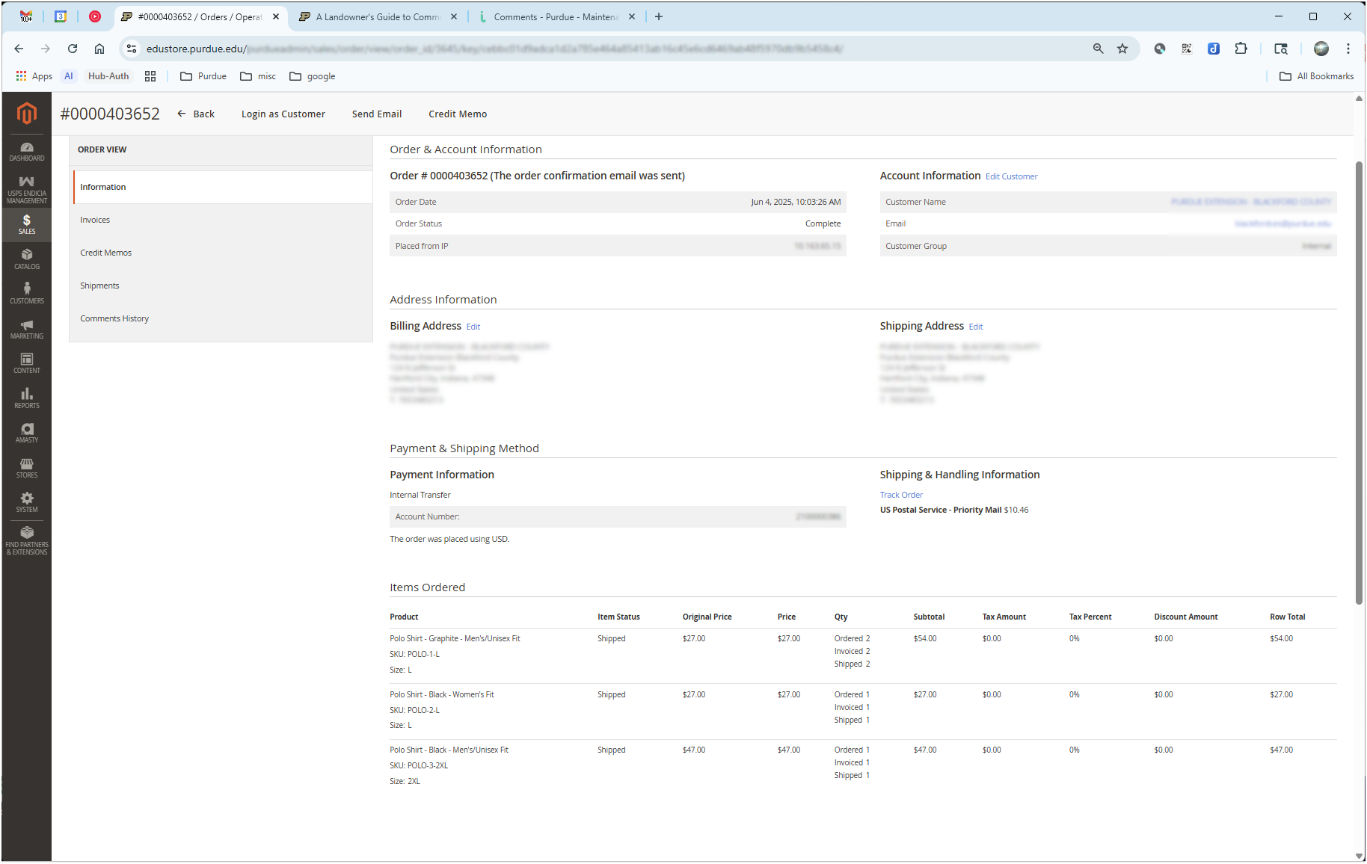
Current Day (2025-?)
How it’s going…
The new Education Store
Back-end
Order Management allows quick view of all orders…
…or drill down to manage individual order

Slide 38
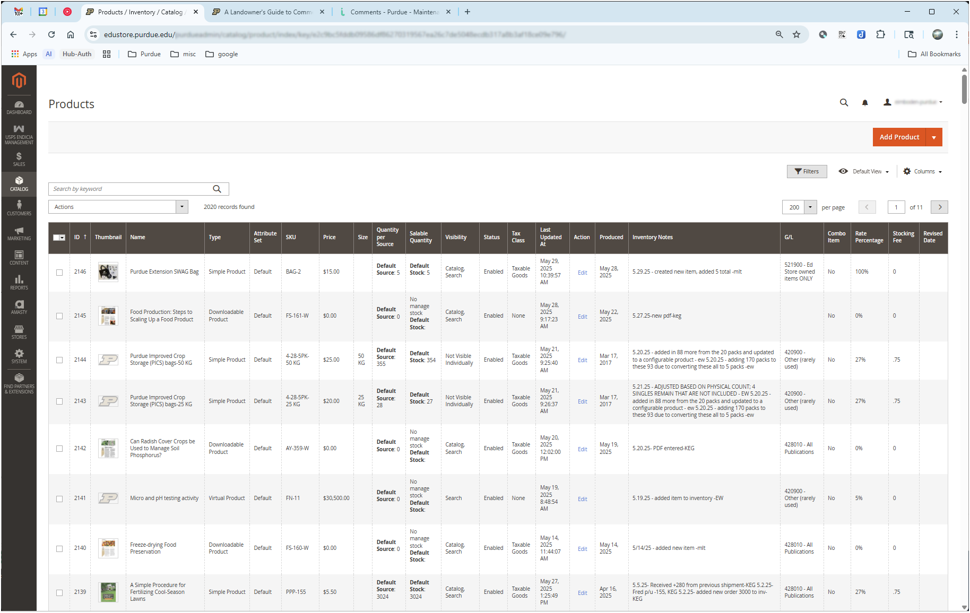
Current Day (2025-?)
How it’s going…
The new Education Store
Back-end
Similarly, Product Management screen allows quick view of all products…

Slide 39
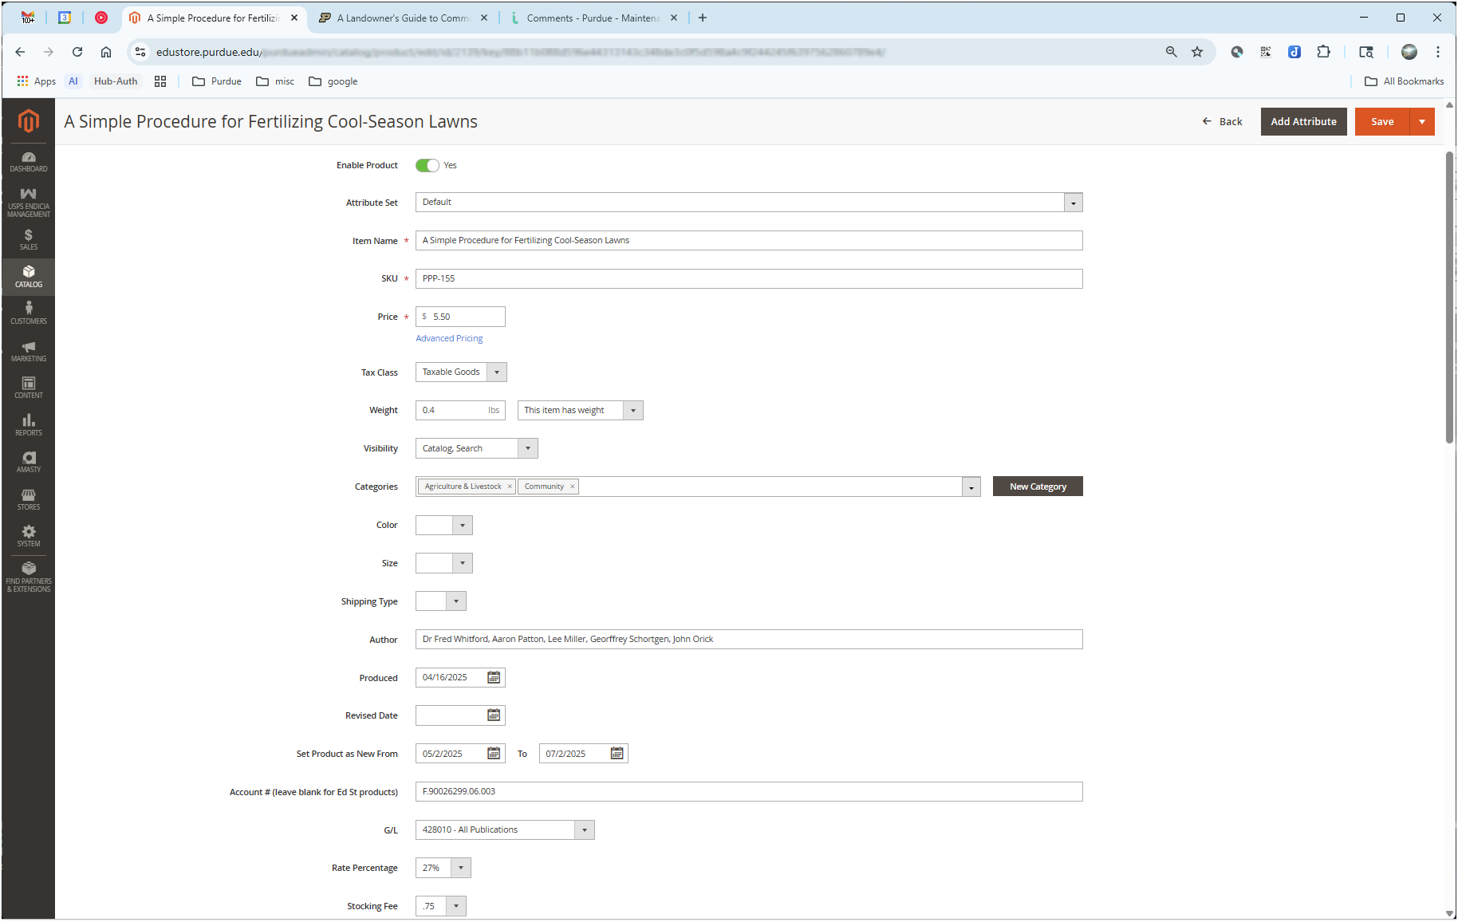
Current Day (2025-?)
How it’s going…
The new Education Store
Back-end
Similarly, Product Management screen allows quick view of all products…
…or drill down to edit a single product’s details

Slide 40
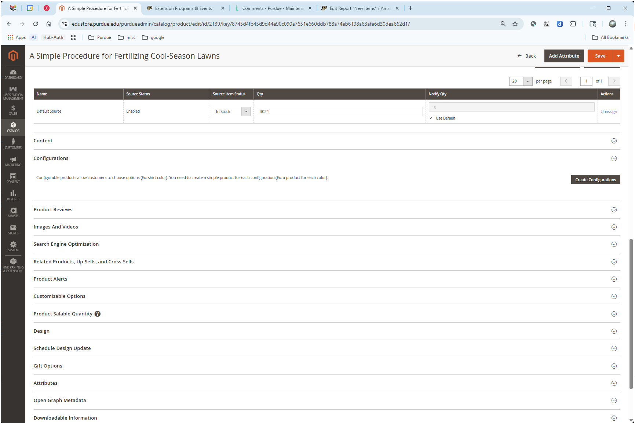
Current Day (2025-?)
How it’s going…
The new Education Store
Back-end
Similarly, Product Management screen allows quick view of all products…
…or drill down to edit a single product’s details
…including content that appears on the product page, product images, SEO data, custom OG tags, etc.

Slide 41
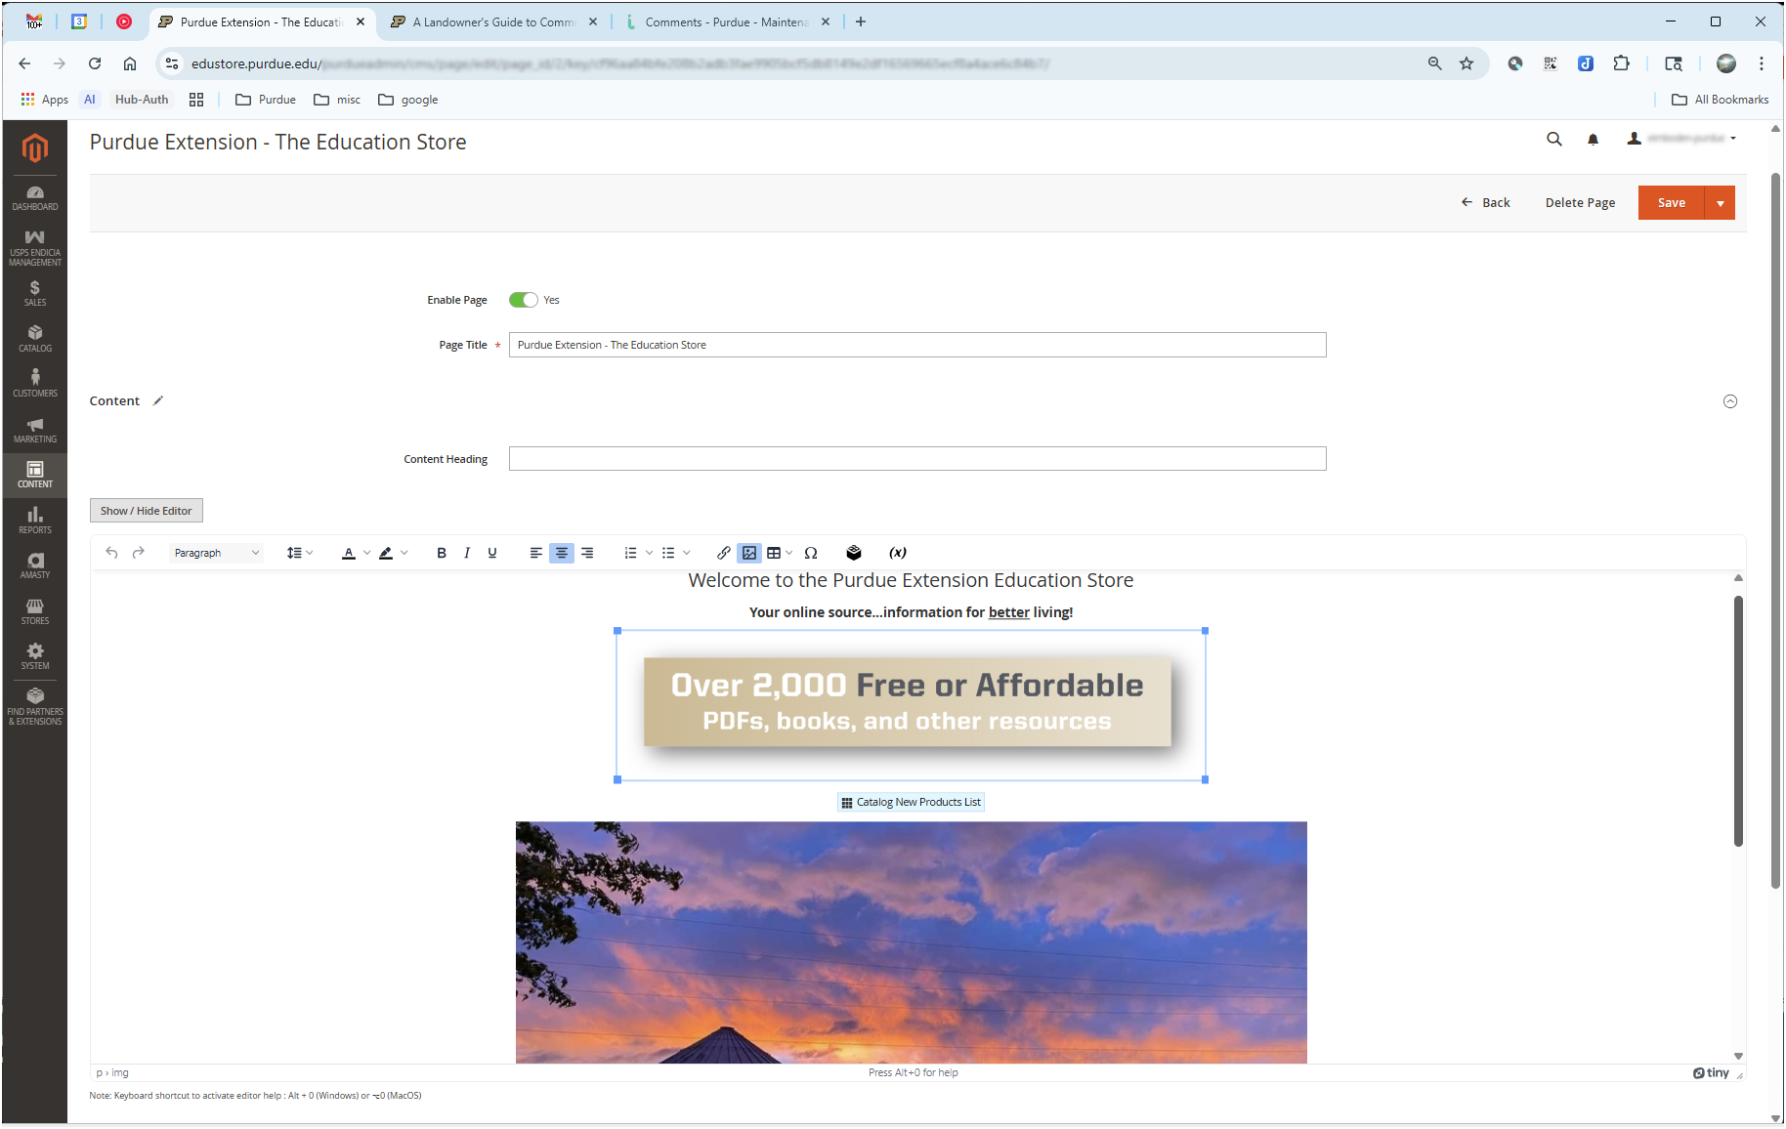
Current Day (2025-?)
How it’s going…
The new Education Store
Back-end
Modern, WYSIWYG editor allows staff to manage site content
Custom blocks and widgets can provide dynamic content

Slide 42
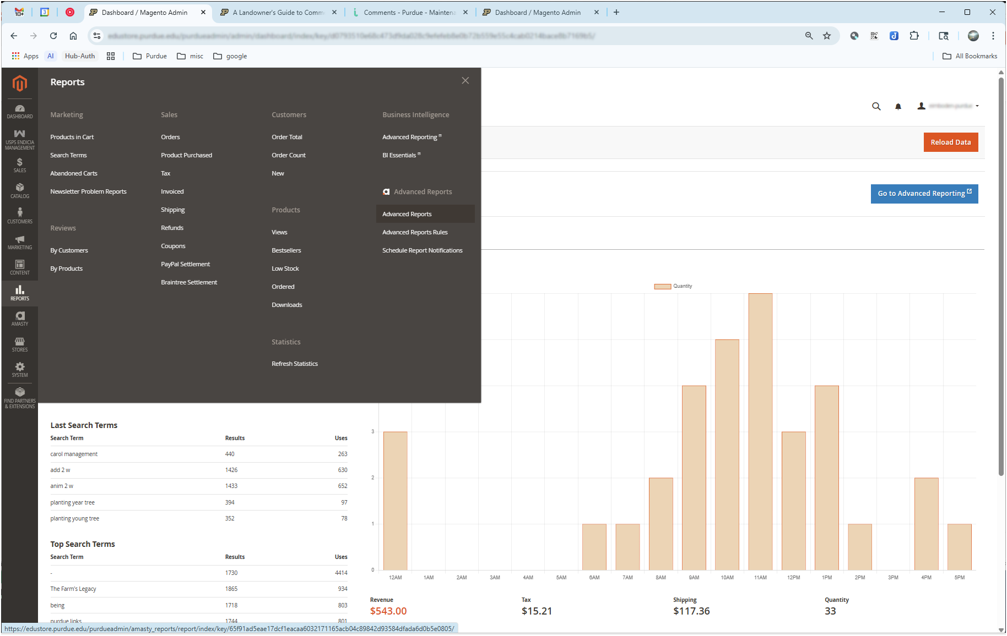
Current Day (2025-?)
How it’s going…
The new Education Store
Back-end
Large selection of reports is available out of the box…
…although our experience showed many of these to be oddly lacking in features, non-customizable, and incomplete

Slide 43
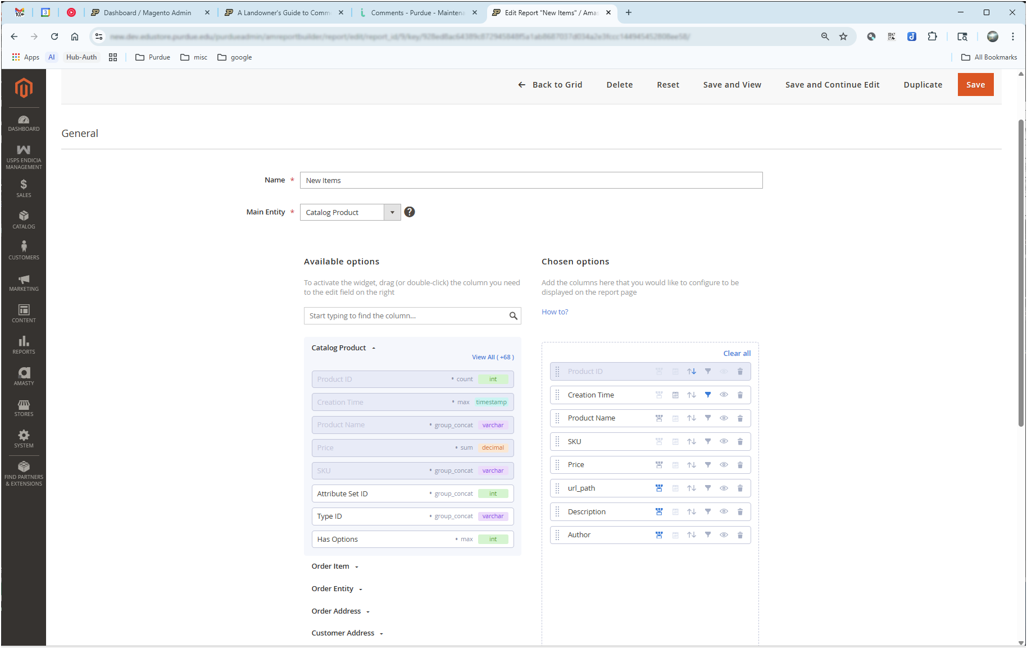
Current Day (2025-?)
How it’s going…
The new Education Store
Back-end
Large selection of reports available out of the box…
…although our experience showed many of these to be oddly lacking in features, non-customizable, and incomplete
However, a Custom Report Builder extension seems to work well so far

Slide 44
Future
What’s next…
The project continues
Site design, user interface improvements
Reports, reports, reports!
Analytics
PDF download reports
Utilize built-in marketing features like RSS feeds or newsletters for customer engagement, product announcements, etc.
Incorporate Event Registrations (replace CVENT)?
Integration with SAP??
Offer online store space to other groups on campus???

Slide 45
Lessons Learned
What worked well, and what would we do differently…
Extremely important to work with an experienced e-commerce consulting/integration partner
Extensions are necessary for additional functionality, but be careful…need to strike a balance between features and stability. The more extensions you install, the more they can cause issues with core Magento and with each other, and the more testing is required at each upgrade/update
Reporting…probably should have paid more attention before launch…should have looked into options earlier (Custom Reporting extension is pretty much a necessity)

Slide 46
Questions?
What else can we tell you…

Slide 47
Thank You

